Slide 1
Modeling Value at Risk (VaR): Deterministic Gaussian VAR Model
Coding Simulation and Implementation
Milestone – 3
Section 1
Group – 4
CSE 400 : Fundamentals of Probability in Computing
Prepared By : Priyam Modi (AU2440030)
Masoom Choksi (AU2440263)

Slide 2
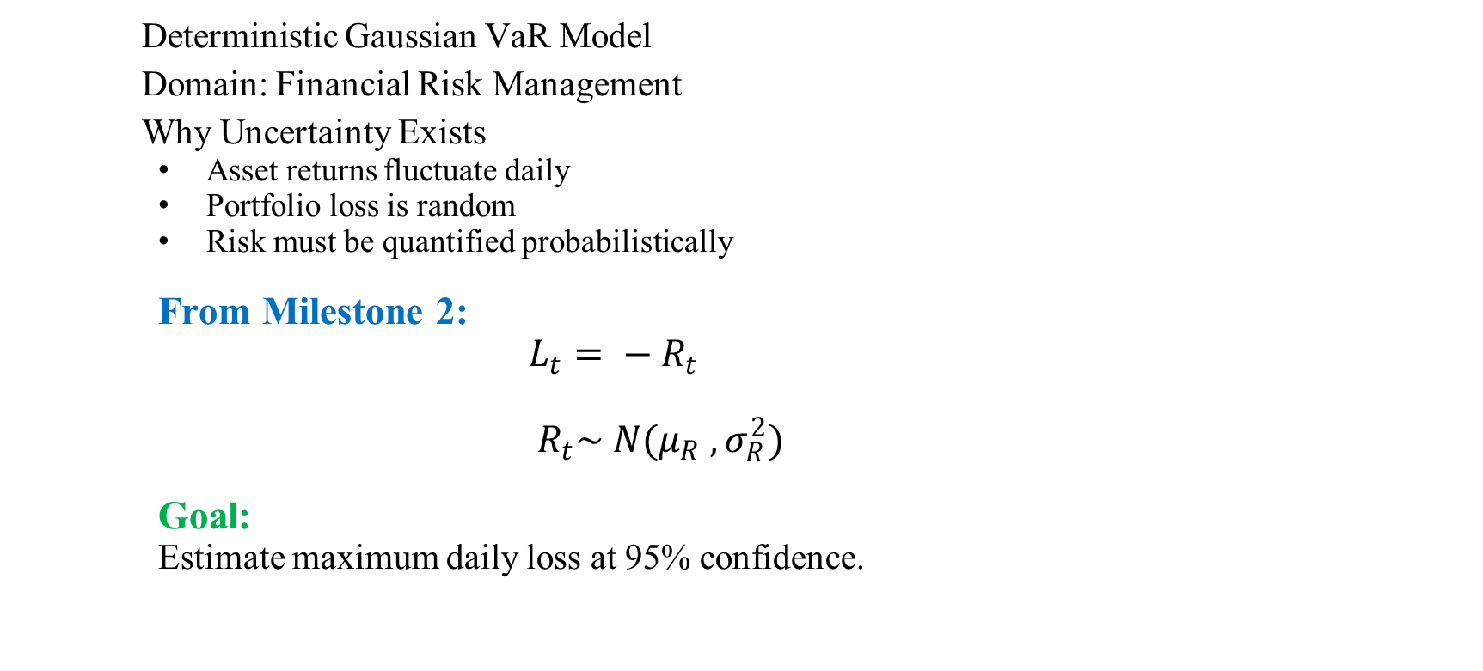
Project Context and Motivation
Deterministic Gaussian VaR Model
Domain: Financial Risk Management
Why Uncertainty Exists
Asset returns fluctuate daily
Portfolio loss is random
Risk must be quantified probabilistically
From Milestone 2:
$L_{t}= − R_{t}$
$R_{t}\sim N(μ_{R} , σ_{R}^{2})$
Goal:
Estimate maximum daily loss at 95% confidence.

Slide 3

Project Objective and Deterministic Baseline
Objective
Implement full working simulation:
Load data
Estimate factor model
Derive loss distribution
Compute closed – form VaR
Perform deterministic backtesting
Deterministic Baseline Strategy
Fixed portfolio weights
Fixed factor exposures
Fixed 95% VaR threshold
Exception if:
$L_{t} > V_{a}R_{0.95}$
No Monte Carlo in decision logic
No adaptive thresholds.
No randomness in rule.

Slide 4
Baseline System Pipeline Overview
End-to-End Implementation
CSV Data
↓
Train-Test Split (80-20)
↓
Portfolio Construction
↓
OLS Factor Regression
↓
Variance Decomposition
↓
Loss Distribution
↓
Closed-Form VaR
↓
Backtesting

Slide 5
Baseline System Pipeline Overview
Where Uncertainty Enters
Factor return variability
Residual noise
Test-period realized losses
Decision rule remains deterministic.

Slide 6
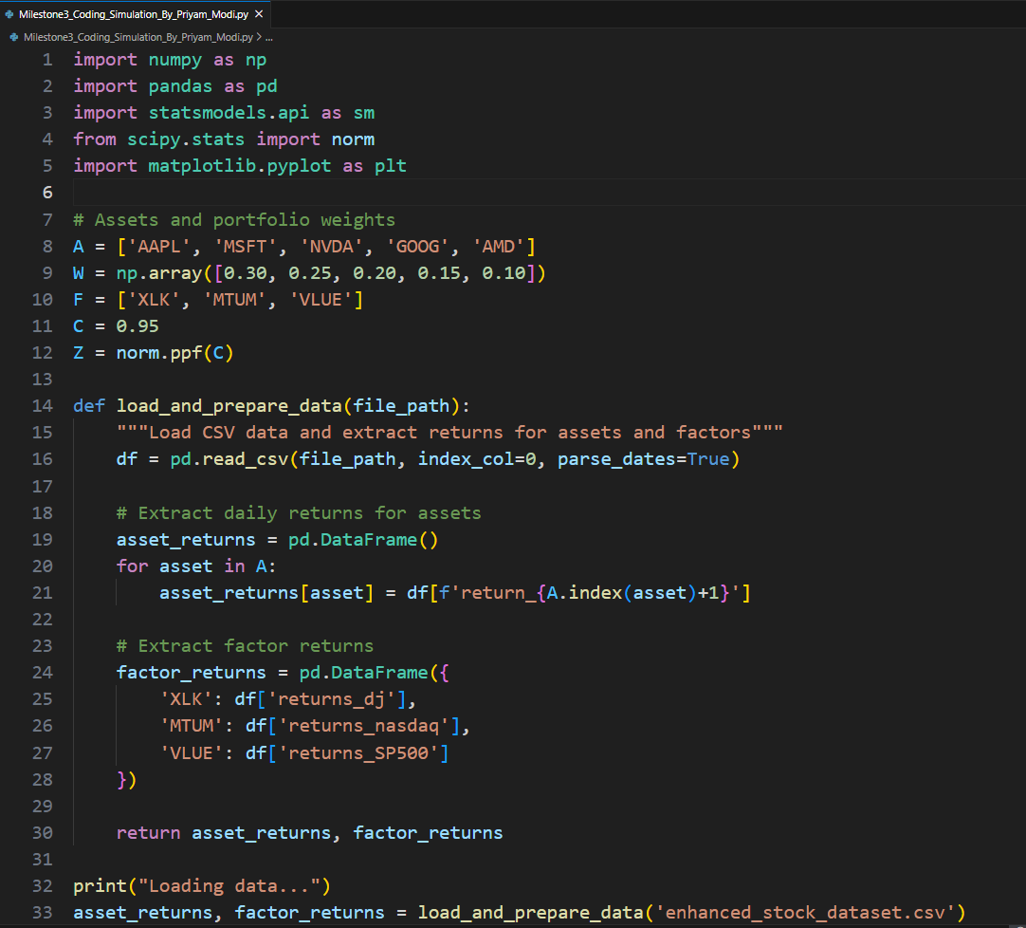

DATA PREPARATION & PORTFOLIO CONSTRUCTION
Code Snippet | Output

Slide 7
DATA PREPARATION & PORTFOLIO CONSTRUCTION
Portfolio Weight Table:
Asset | Ticker | Weight
Apple | AAPL | 30%
Microsoft | MSFT | 25%
NVIDIA | NVDA | 20%
Alphabet | GOOG | 15%
AMD | AMD | 10%
Factor Used:
Factor | Description | Proxy Used
XLK | Technology Sector | Dow Jones Returns
MTUM | Momentum Factor | NASDAQ Returns
VLUE | Value Factor | S&P 500 Returns

Slide 8
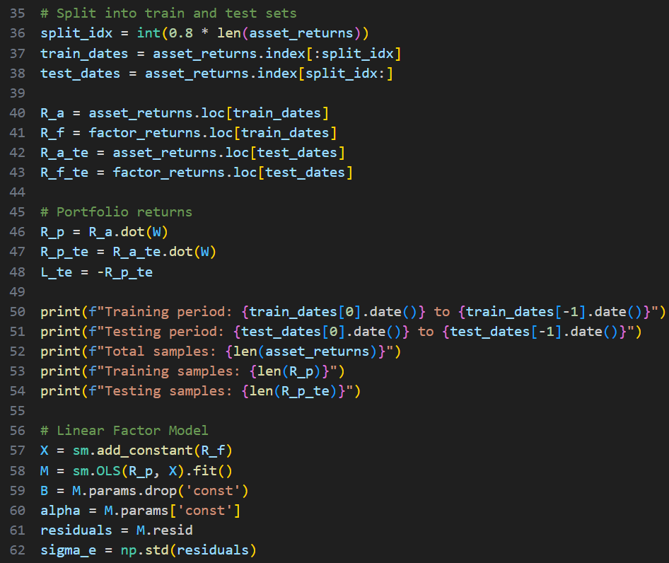
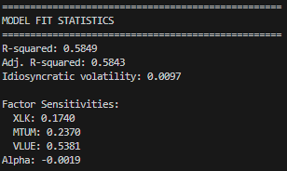
LINEAR FACTOR MODEL ESTIMATION
Code Snippet | Output

Slide 9
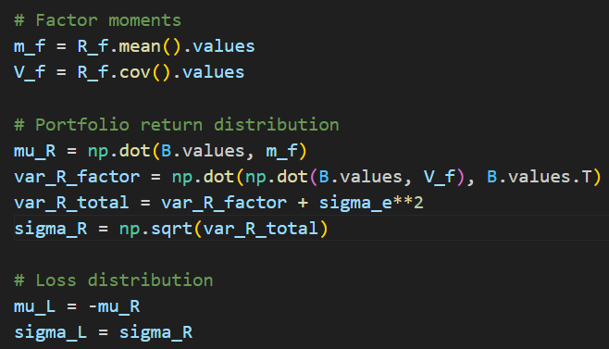
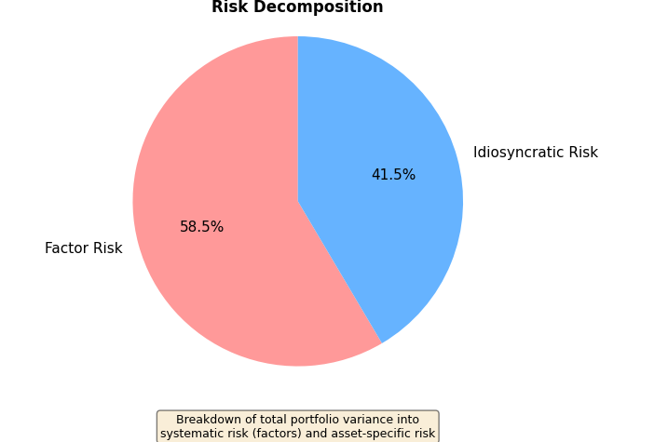
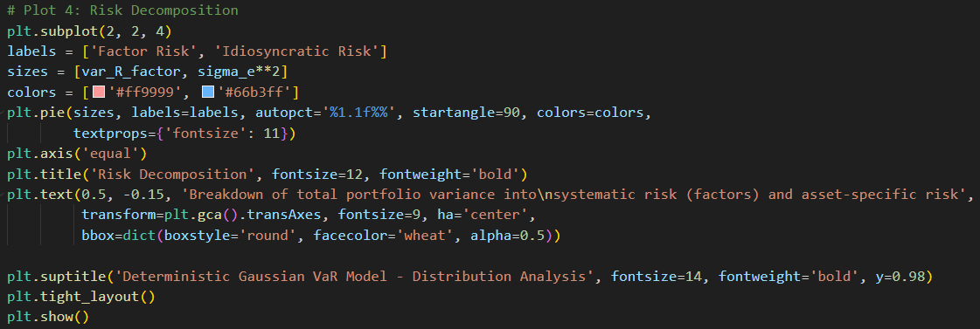
VARIANCE DECOMPOSITION & RISK ANALYSIS
Code Snippet | Output

Slide 10
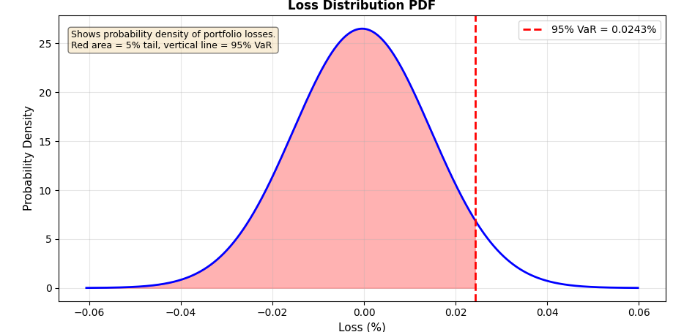
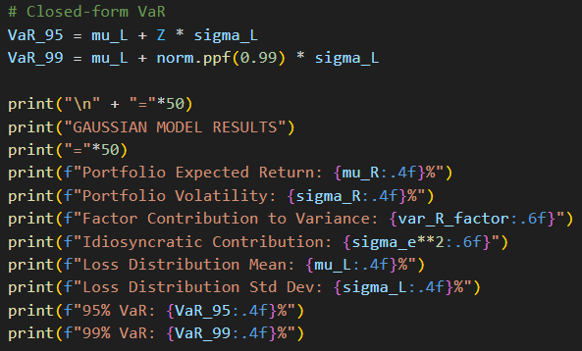
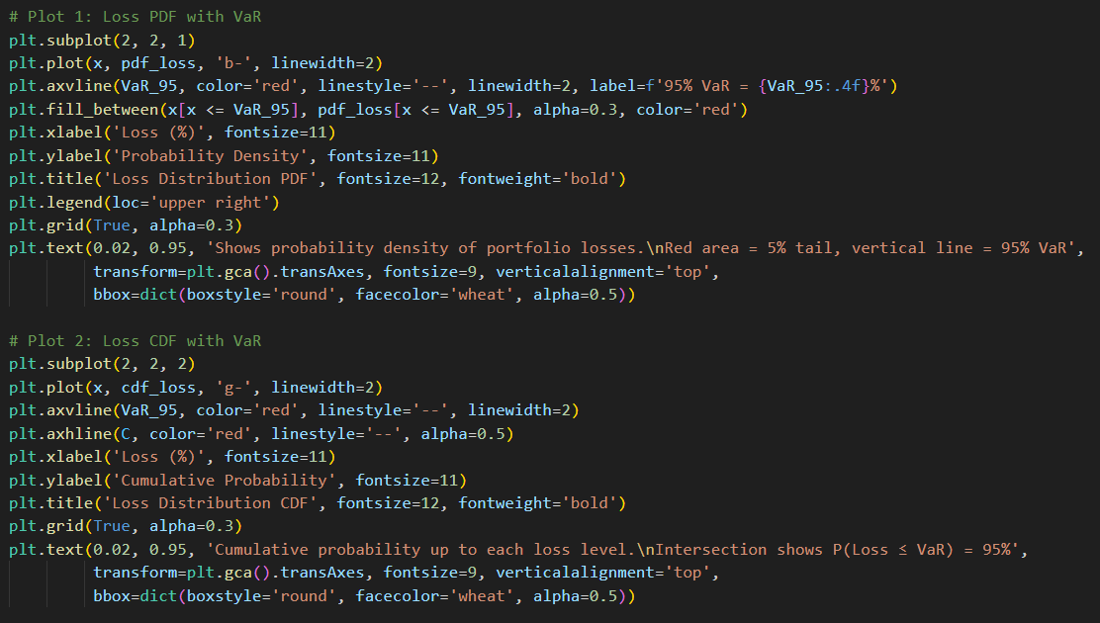
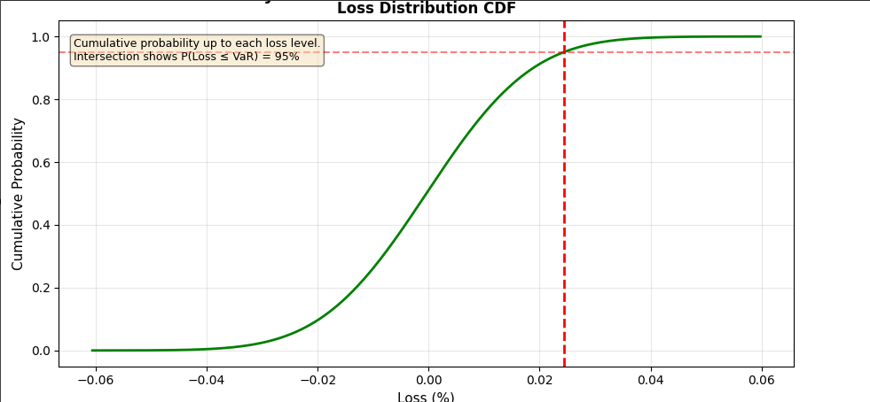
LOSS DISTRIBUTION & VAR CALCULATION
Code Snippet | Graph-Simulation

Slide 11
LOSS DISTRIBUTION & VAR CALCULATION
Metric | Daily Value
Expected Return (μ_R) | 0.0004%
Portfolio Volatility (σ_R) | 0.0151%
Loss Distribution Mean (μ_L) | -0.0004%
Loss Distribution Std Dev (σ_L) | 0.0151%
95% VaR | 0.0243%
99% VaR | 0.0346%

Slide 12
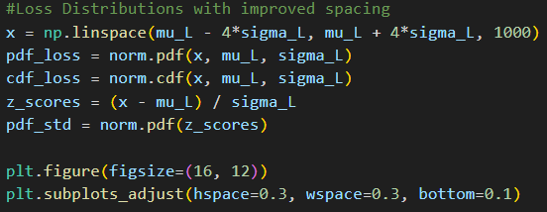
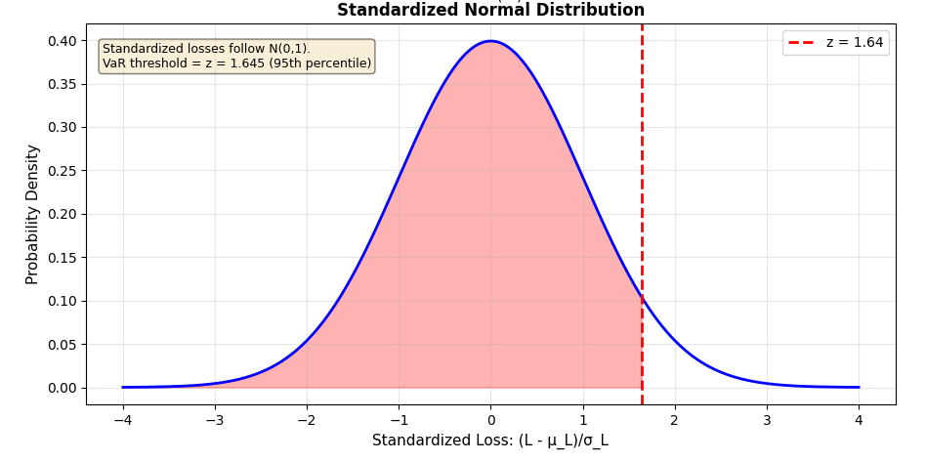
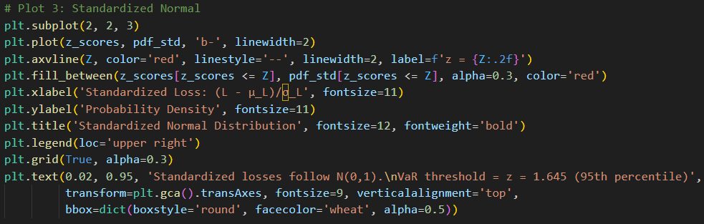
STANDARDIZED NORMAL DISTRIBUTION
Code Snippet | Graph-Simulation

Slide 13
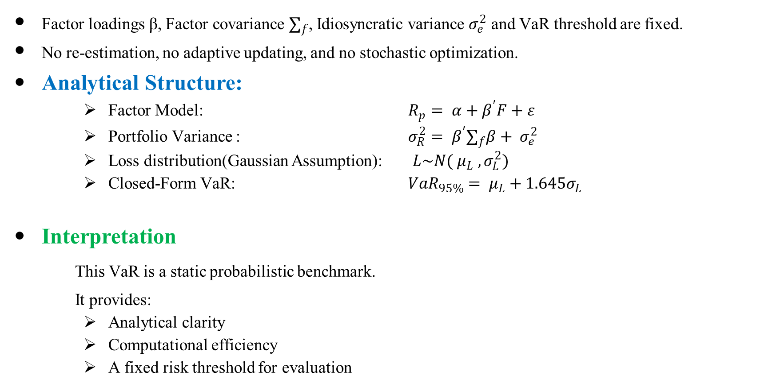
Deterministic Baseline Logic
Factor loadings β, Factor covariance $∑_{f}$, Idiosyncratic variance $σ_{e}^{2}$ and VaR threshold are fixed.
No re-estimation, no adaptive updating, and no stochastic optimization.
Analytical Structure:
Factor Model: $R_{p}= α+β^{′}F+ε$
Portfolio Variance : $σ_{R}^{2}= β^{′}∑_{f}β+ σ_{e}^{2}$
Loss distribution(Gaussian Assumption): $L\sim N( μ_{L} , σ_{L}^{2})$
Closed-Form VaR: $VaR_{95\%}= μ_{L}+1.645σ_{L}$
Interpretation
This VaR is a static probabilistic benchmark.
It provides:
Analytical clarity
Computational efficiency
A fixed risk threshold for evaluation

Slide 14
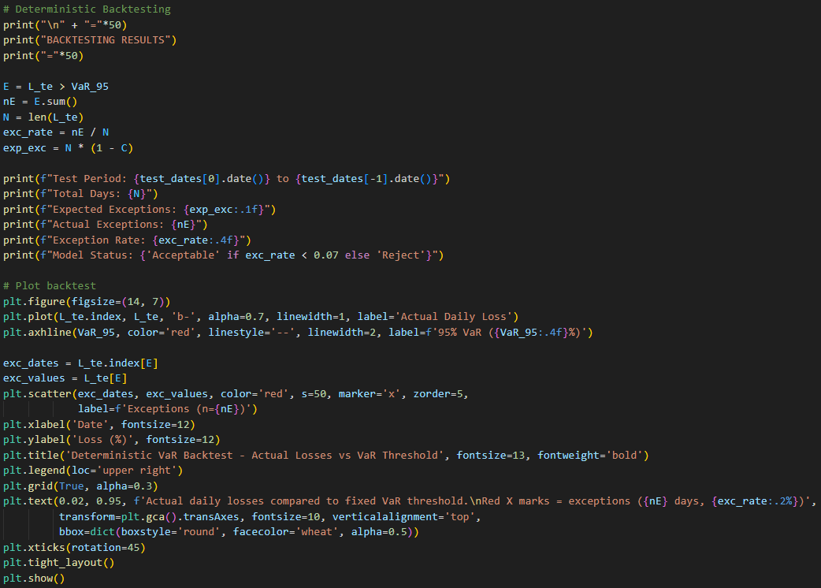
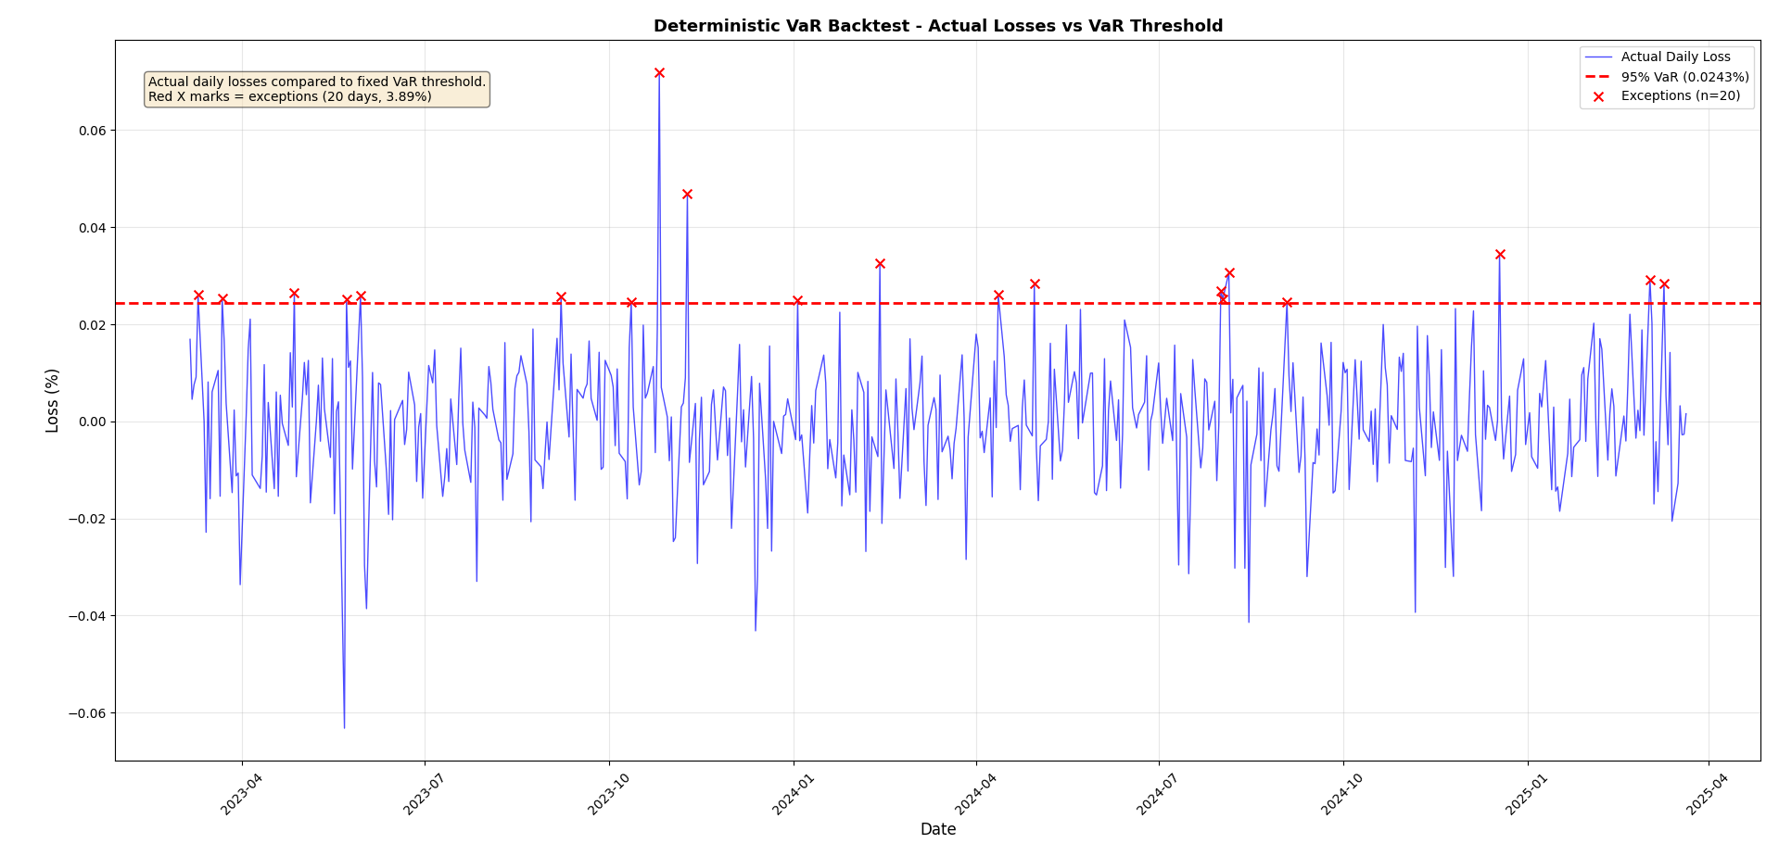
BACKTESTING RESULTS
Code Snippet | Graph-Simulation

Slide 15
Performance Analysis of Deterministic Baseline
Strengths
Stable across the test period
Slightly conservative risk estimates
Computationally efficient
Fully interpretable framework
Limitations
Assume Gaussian tail risk
Static parameters (no dynamic updating)

Slide 16
Summary and Transition
What Milestone 3 achieved
Full end–to–end simulation
Deterministic VaR baseline
Analytical implementation
Out- of- Sample validation
Why randomized Strategies Next?
Improved tail risk modelling
Stress scenario simulation
Adaptive risk thresholds
Monte Carlo flexibility

Slide 17
References
https://www.kaggle.com/datasets/muhammadahmad246/enhanced-stock-market-dataset?resource=download

